Slide 1
Mechanisms and Robotics DE ES DM ZG561
Lecture - 5

Slide 2
Robot Kinematics
Forward kinematics
Rotation
Translation
Post-multiplication Vs. Pre-multiplication
Homogeneous Transformation
Introduction to Denavit – Hartenberg Parameters
θ – r manipulator

Slide 3
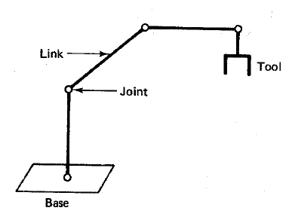
Direct Kinematics
A robotic manipulator can be modelled as a chain of rigid bodies called links.
The links are interconnected to one other by joints.
The objective is to control both the position and the orientation of the tool in three dimensional space.
In order to program the tool we must formulate the relationship between the joint variables and the position and the orientation of the tool.
This is called the Direct Kinematics problem.

Slide 4
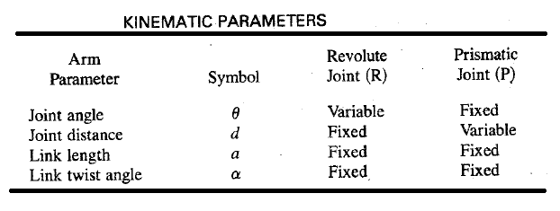
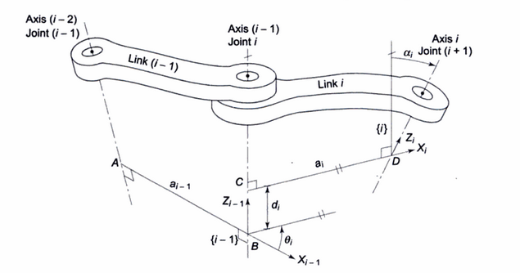
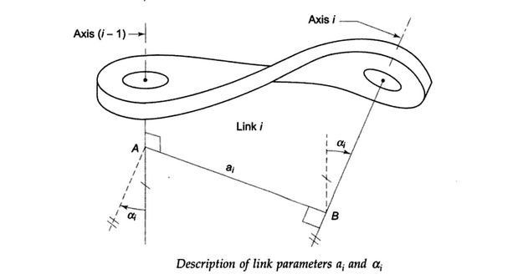
Kinematic Parameters
Joint Parameters
Link Parameters

Slide 5
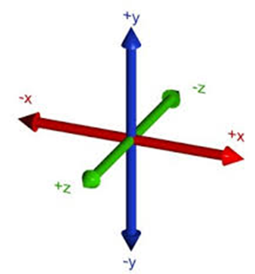
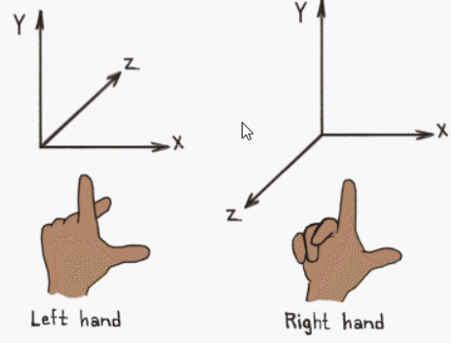
Coordinate Systems – Right Handed, Left Handed
Directions of Positive X Y Z axes

Slide 6
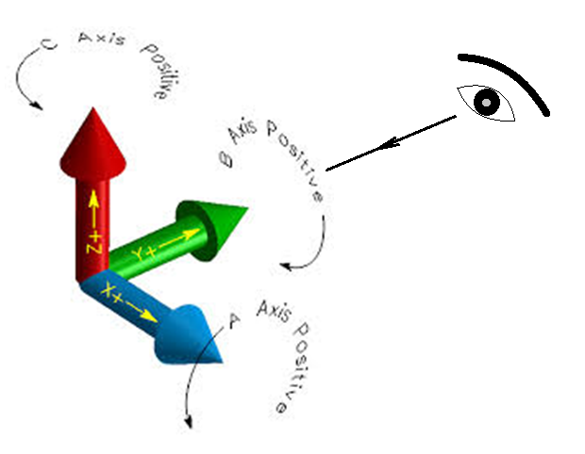
Coordinate Systems
Directions of Positive X Y Z rotations
Anticlockwise rotation is positive when seen from the opposite direction of the arrow head

Slide 7
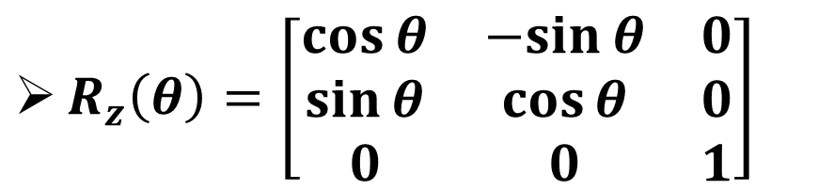

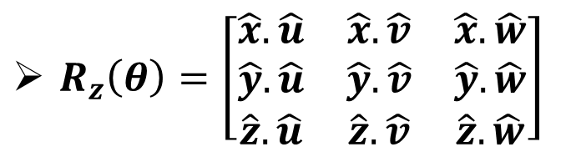

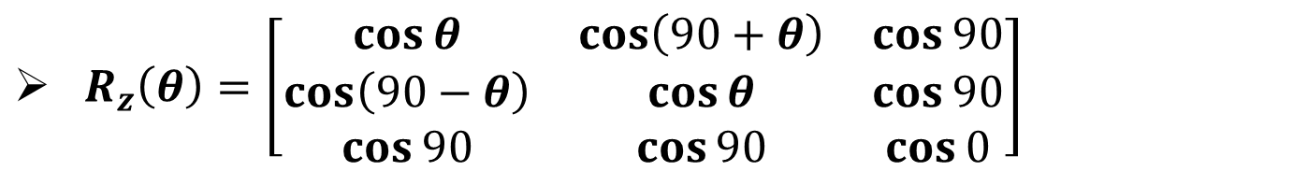




Rotation Matrices
$$\hat{v}$$
$R_{z}\left(θ\right)=\left[\begin{matrix}\hat{x}.\hat{u} & \hat{x}.\hat{v} & \hat{x}.\hat{w} \\ \hat{y}.\hat{u} & \hat{y}.\hat{v} & \hat{y}.\hat{w} \\ \hat{z}.\hat{u} & \hat{z}.\hat{v} & \hat{z}.\hat{w}\end{matrix}\right]$
$$θ$$
$$\hat{y}$$
$$θ$$
$R_{z}\left(θ\right)=\left[\begin{matrix}\cos{θ} & \cos\left(90+θ\right) & \cos{90} \\ \cos\left(90−θ\right) & \cos{θ} & \cos{90} \\ \cos{90} & \cos{90} & \cos{0}\end{matrix}\right]$
$$\hat{u}$$
$$\hat{x}$$
$R_{z}\left(θ\right)=\left[\begin{matrix}\cos{θ} & −sin{θ} & 0 \\ \sin{θ} & \cos{θ} & 0 \\ 0 & 0 & 1\end{matrix}\right]$

Slide 8
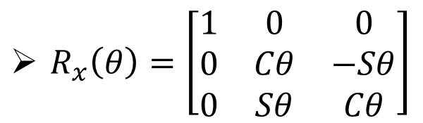
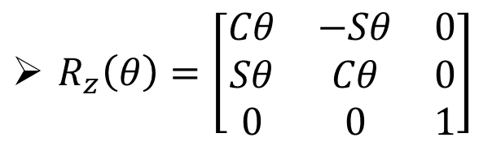
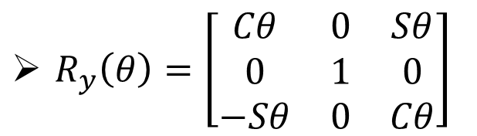
Rotation Matrices
Fundamental rotation matrices for rotation about x axis y axis and z axis are given as follows.
$R_{x}\left(θ\right)=\left[\begin{matrix}1 & 0 & 0 \\ 0 & Cθ & −Sθ \\ 0 & Sθ & Cθ\end{matrix}\right]$
$R_{y}\left(θ\right)=\left[\begin{matrix}Cθ & 0 & Sθ \\ 0 & 1 & 0 \\ −Sθ & 0 & Cθ\end{matrix}\right]$
$R_{z}\left(θ\right)=\left[\begin{matrix}Cθ & −Sθ & 0 \\ Sθ & Cθ & 0 \\ 0 & 0 & 1\end{matrix}\right]$

Slide 9
Problem 1
Find the result of rotating the point [7,2,5]T through 90° in the positive direction about the z-axis.

Slide 10
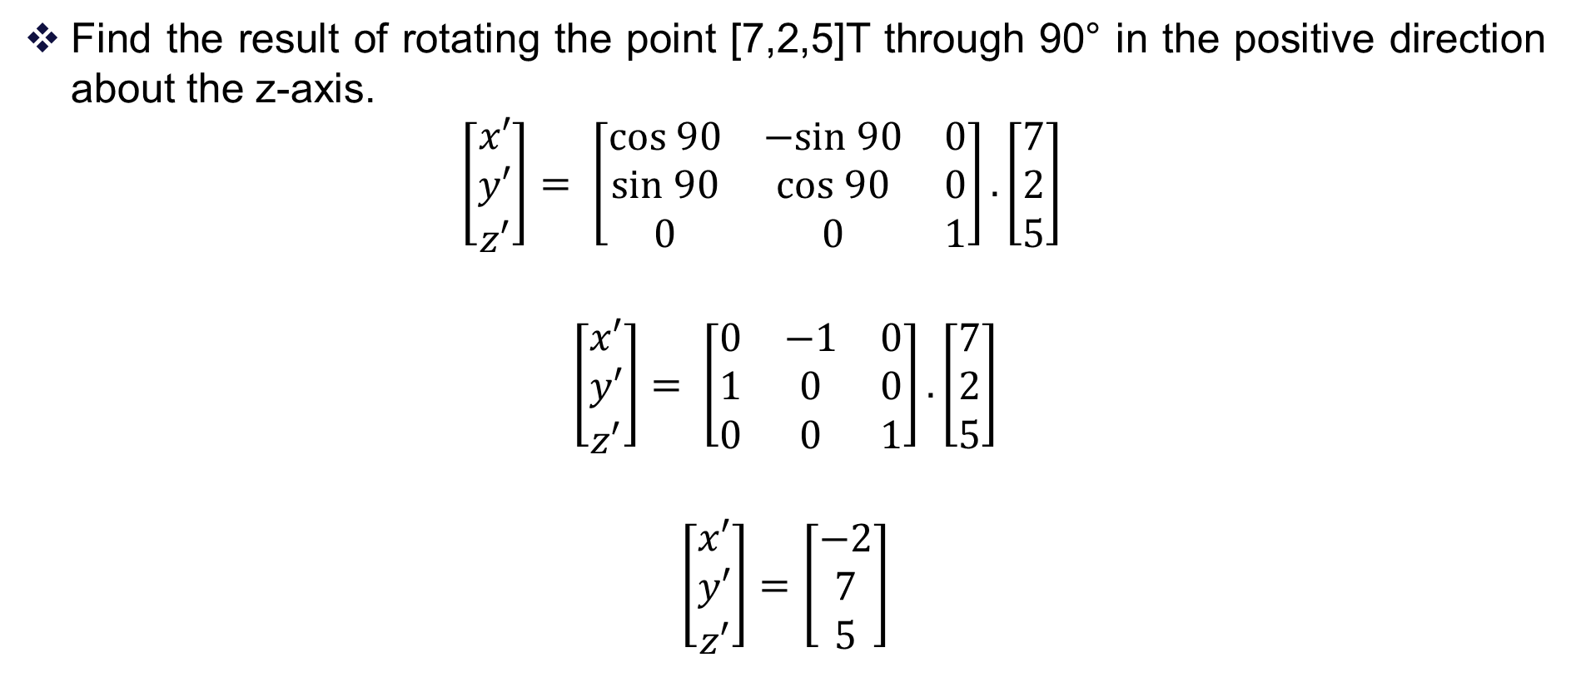
Problem 1 - Solution
Find the result of rotating the point [7,2,5]T through 90° in the positive direction about the z-axis.
$$\left[\begin{matrix}x′ \\ y′ \\ z′\end{matrix}\right]= \left[\begin{matrix}cos 90 & −sin 90 & 0 \\ sin 90 & cos 90 & 0 \\ 0 & 0 & 1\end{matrix}\right].\left[\begin{matrix}7 \\ 2 \\ 5\end{matrix}\right]$$
$$\left[\begin{matrix}x′ \\ y′ \\ z′\end{matrix}\right]= \left[\begin{matrix}0 & −1 & 0 \\ 1 & 0 & 0 \\ 0 & 0 & 1\end{matrix}\right].\left[\begin{matrix}7 \\ 2 \\ 5\end{matrix}\right]$$
$$\left[\begin{matrix}x′ \\ y′ \\ z′\end{matrix}\right]=\left[\begin{matrix}−2 \\ 7 \\ 5\end{matrix}\right]$$

Slide 11
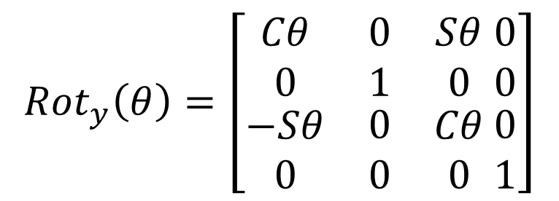
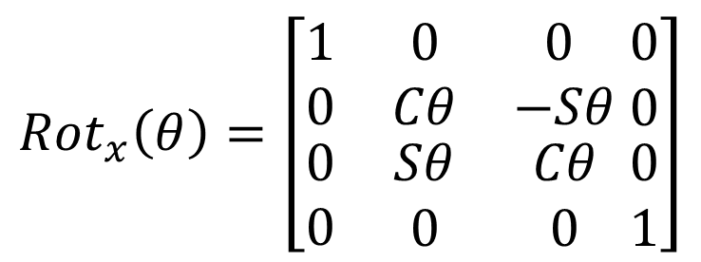

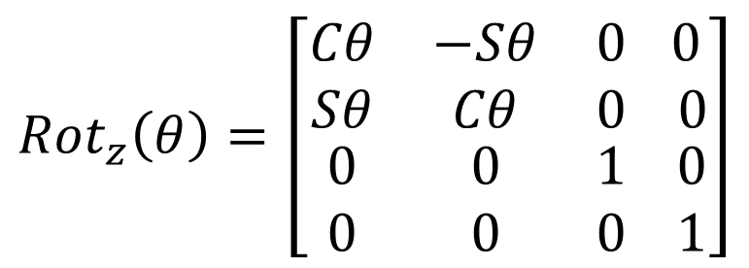
Homogeneous Transformation Matrices
When we want to describe a generalized transformation by a single matrix that combines the effects of translation and rotation, we define a vector by adding 1.
$$V=\left[ \begin{matrix}x \\ y \\ \begin{matrix}z \\ 1\end{matrix}\end{matrix}\right]$$
$${Rot}_{x}\left(θ\right)=\left[\begin{matrix}1 & 0 & 0 \\ 0 & Cθ & −Sθ \\ \begin{matrix}0 \\ 0\end{matrix} & \begin{matrix}Sθ \\ 0\end{matrix} & \begin{matrix}Cθ \\ 0\end{matrix}\end{matrix} \begin{matrix}0 \\ 0 \\ \begin{matrix}0 \\ 1\end{matrix}\end{matrix}\right]$$
$${Rot}_{z}\left(θ\right)=\left[\begin{matrix}Cθ & −Sθ & 0 \\ Sθ & Cθ & 0 \\ \begin{matrix}0 \\ 0\end{matrix} & \begin{matrix}0 \\ 0\end{matrix} & \begin{matrix}1 \\ 0\end{matrix}\end{matrix} \begin{matrix} 0 \\ 0 \\ \begin{matrix}0 \\ 1\end{matrix}\end{matrix}\right]$$
$${Rot}_{y}\left(θ\right)=\left[\begin{matrix}Cθ & 0 & Sθ \\ 0 & 1 & 0 \\ \begin{matrix}−Sθ \\ 0\end{matrix} & \begin{matrix}0 \\ 0\end{matrix} & \begin{matrix}Cθ \\ 0\end{matrix}\end{matrix} \begin{matrix}0 \\ 0 \\ \begin{matrix}0 \\ 1\end{matrix}\end{matrix}\right]$$

Slide 12
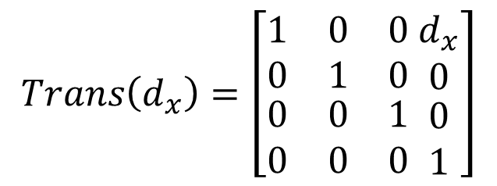
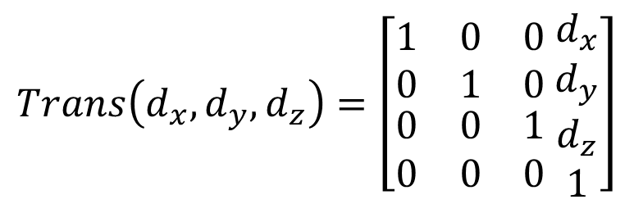
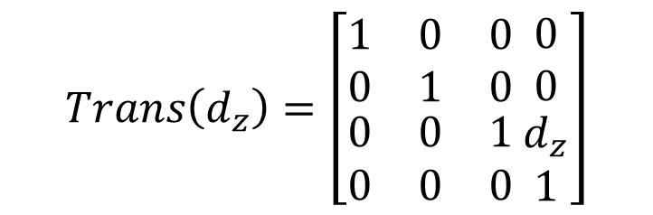
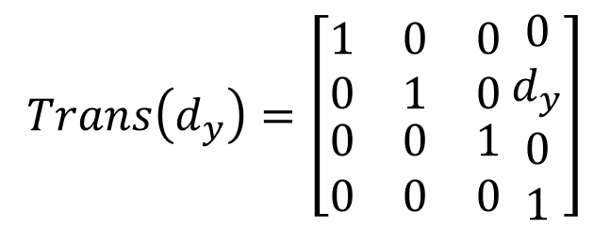
Homogeneous Transformation Matrices
$$Trans\left(d_{x},d_{y},d_{z}\right)=\left[\begin{matrix}1 & 0 & 0 \\ 0 & 1 & 0 \\ \begin{matrix}0 \\ 0\end{matrix} & \begin{matrix}0 \\ 0\end{matrix} & \begin{matrix}1 \\ 0\end{matrix}\end{matrix} \begin{matrix}d_{x} \\ d_{y} \\ \begin{matrix}d_{z} \\ 1\end{matrix}\end{matrix}\right]$$
$$Trans\left(d_{x}\right)=\left[\begin{matrix}1 & 0 & 0 \\ 0 & 1 & 0 \\ \begin{matrix}0 \\ 0\end{matrix} & \begin{matrix}0 \\ 0\end{matrix} & \begin{matrix}1 \\ 0\end{matrix}\end{matrix} \begin{matrix}d_{x} \\ 0 \\ \begin{matrix}0 \\ 1\end{matrix}\end{matrix}\right]$$
$$Trans\left(d_{z}\right)=\left[\begin{matrix}1 & 0 & 0 \\ 0 & 1 & 0 \\ \begin{matrix}0 \\ 0\end{matrix} & \begin{matrix}0 \\ 0\end{matrix} & \begin{matrix}1 \\ 0\end{matrix}\end{matrix} \begin{matrix}0 \\ 0 \\ \begin{matrix}d_{z} \\ 1\end{matrix}\end{matrix}\right]$$
$$Trans\left(d_{y}\right)=\left[\begin{matrix}1 & 0 & 0 \\ 0 & 1 & 0 \\ \begin{matrix}0 \\ 0\end{matrix} & \begin{matrix}0 \\ 0\end{matrix} & \begin{matrix}1 \\ 0\end{matrix}\end{matrix} \begin{matrix}0 \\ d_{y} \\ \begin{matrix}0 \\ 1\end{matrix}\end{matrix}\right]$$

Slide 13
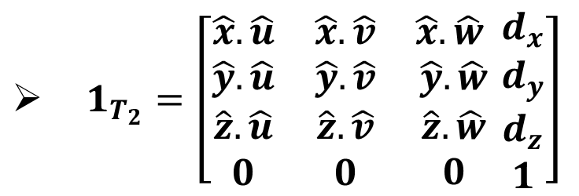
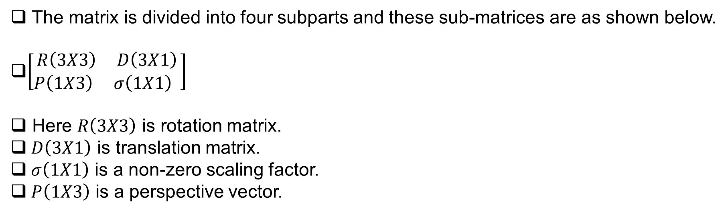
Homogeneous Transformation Matrices
$1_{T_{2}}=\left[\begin{matrix}\hat{x}.\hat{u} & \hat{x}.\hat{v} & \hat{x}.\hat{w} \\ \hat{y}.\hat{u} & \hat{y}.\hat{v} & \hat{y}.\hat{w} \\ \begin{matrix}\hat{z}.\hat{u} \\ 0\end{matrix} & \begin{matrix}\hat{z}.\hat{v} \\ 0\end{matrix} & \begin{matrix}\hat{z}.\hat{w} \\ 0\end{matrix}\end{matrix} \begin{matrix}d_{x} \\ d_{y} \\ \begin{matrix}d_{z} \\ 1\end{matrix}\end{matrix}\right]$
The matrix is divided into four subparts and these sub-matrices are as shown below.
$\left[\begin{aligned}R\left(3X3\right) D\left(3X1\right) \\ P\left(1X3\right) σ\left(1X1\right) \end{aligned}\right]$
Here $R\left(3X3\right)$ is rotation matrix.
$D\left(3X1\right)$ is translation matrix.
$σ\left(1X1\right)$ is a non-zero scaling factor.
$P\left(1X3\right)$ is a perspective vector.

Slide 14
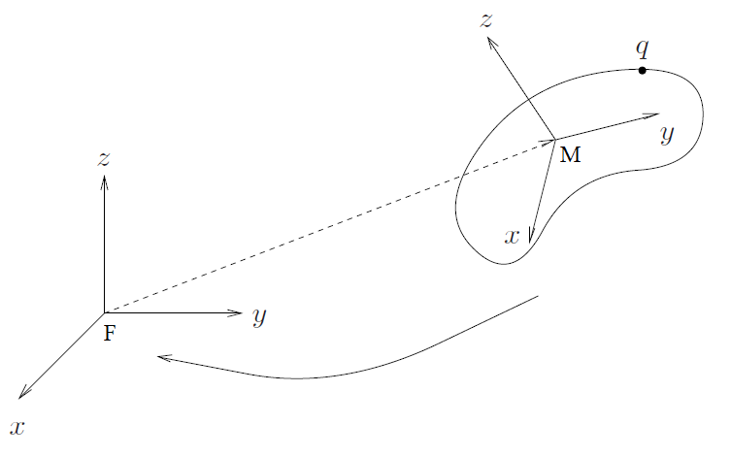
Post-Multiplication Vs. Pre-Multiplication
Composite Rotations
If the mobile coordinate frame M is to be rotated by an amount ϕ about the K^{th} unit vector of the fixed coordinate frame F, then pre-multiply R by Rk(ϕ)
If the mobile coordinate frame M is to be rotated by an amount ϕ about its own K^{th} unit vector, then post-multiply R by Rk(ϕ)

Slide 15
Problem 2
Find the result of rotating the point [7,2,5]T through 90° in the positive direction about the z-axis followed by a rotation of 90° about the x-axis, followed by a translation of (4,5,6).

Slide 16
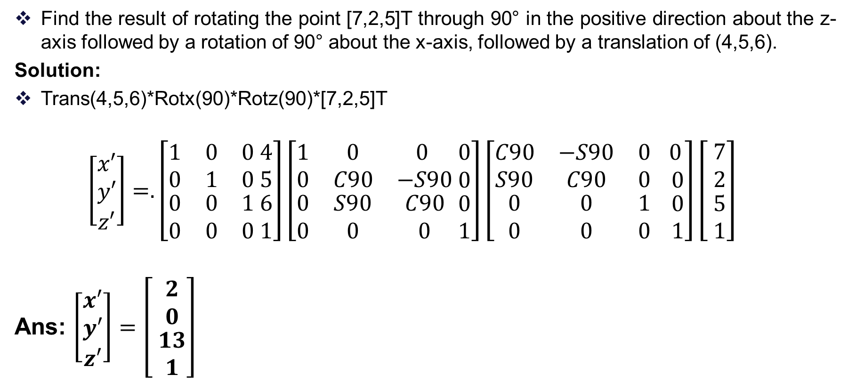
Problem 2 - Solution
Find the result of rotating the point [7,2,5]T through 90° in the positive direction about the z-axis followed by a rotation of 90° about the x-axis, followed by a translation of (4,5,6).
Solution:
Trans(4,5,6)*Rotx(90)*Rotz(90)*[7,2,5]T
$$\left[\begin{matrix}x′ \\ y′ \\ z′\end{matrix}\right]=.\left[\begin{matrix}1 & 0 & 0 \\ 0 & 1 & 0 \\ \begin{matrix}0 \\ 0\end{matrix} & \begin{matrix}0 \\ 0\end{matrix} & \begin{matrix}1 \\ 0\end{matrix}\end{matrix} \begin{matrix}4 \\ 5 \\ \begin{matrix}6 \\ 1\end{matrix}\end{matrix}\right]\left[\begin{matrix}1 & 0 & 0 \\ 0 & C90 & −S90 \\ \begin{matrix}0 \\ 0\end{matrix} & \begin{matrix}S90 \\ 0\end{matrix} & \begin{matrix}C90 \\ 0\end{matrix}\end{matrix} \begin{matrix}0 \\ 0 \\ \begin{matrix}0 \\ 1\end{matrix}\end{matrix}\right]\left[\begin{matrix}C90 & −S90 & 0 \\ S90 & C90 & 0 \\ \begin{matrix}0 \\ 0\end{matrix} & \begin{matrix}0 \\ 0\end{matrix} & \begin{matrix}1 \\ 0\end{matrix}\end{matrix} \begin{matrix} 0 \\ 0 \\ \begin{matrix}0 \\ 1\end{matrix}\end{matrix}\right]\left[ \begin{matrix}7 \\ 2 \\ \begin{matrix}5 \\ 1\end{matrix}\end{matrix}\right]$$
Ans: $\left[\begin{matrix}x′ \\ y′ \\ z′\end{matrix}\right]=\left[ \begin{matrix}2 \\ 0 \\ \begin{matrix}13 \\ 1\end{matrix}\end{matrix}\right]$

Slide 18
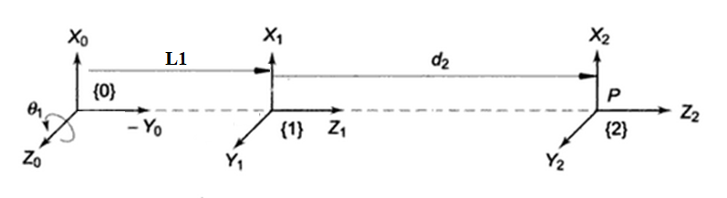
Denavit - Hartenberg Representation
Denavit and Hartenberg (1955) proposed a systematic notation scheme for assigning right handed orthonormal coordinate frames, one to each link in an open kinematic chain of links.
Once these coordinated frames are assigned, transformations between adjacent coordinate frames can be represented by a single standard 4X4 homogeneous coordinate transformation matrix.

Slide 20
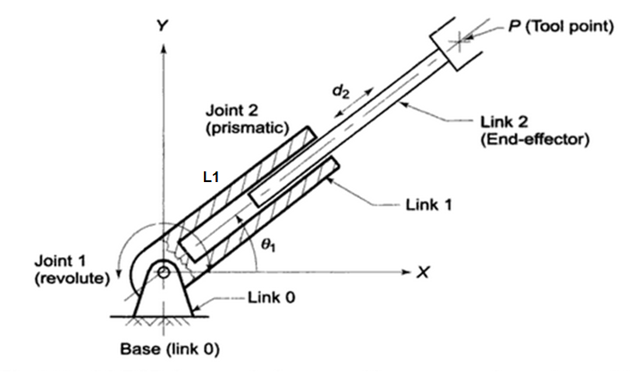
2 dof manipulator – Forward Kinematics

Slide 21

2 dof manipulator – Link Coordinate Diagram
Solution:
[x’,y’,z’] = Rotz (θ1)*Transx(L1)*Rotz(90)* Rotx(90)* Transz(d2)* [0,0,0]’

Slide 22
2 dof manipulator – D-H Parameters
Link i | θ | d | α | a | Home
1 | θ1 |  | 90 | L1 | 90
2 |  | d2

Slide 23
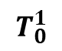
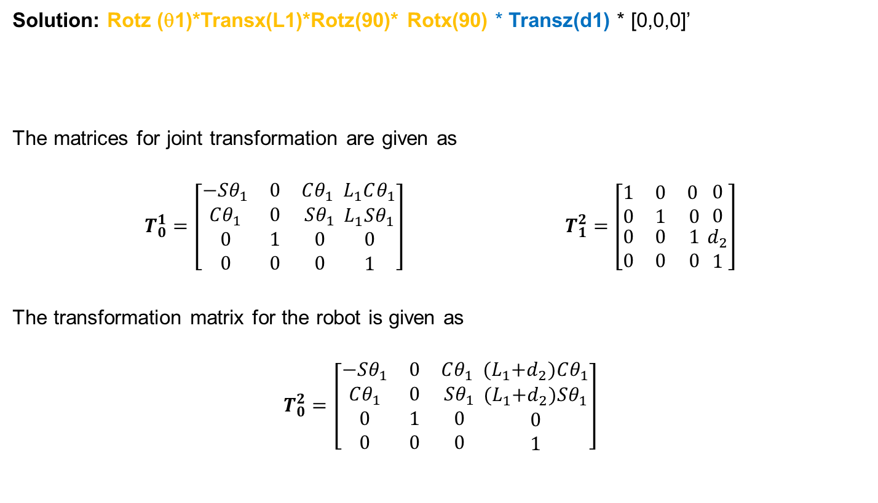
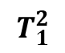
2 dof manipulator – Forward Kinematics
Solution: Rotz (θ1)*Transx(L1)*Rotz(90)* Rotx(90) * Transz(d1) * [0,0,0]’
The matrices for joint transformation are given as
$$T_{0}^{1}=\left[\begin{matrix}−Sθ_{1} & 0 & Cθ_{1} \\ Cθ_{1} & 0 & Sθ_{1} \\ \begin{matrix}0 \\ 0\end{matrix} & \begin{matrix}1 \\ 0\end{matrix} & \begin{matrix}0 \\ 0\end{matrix}\end{matrix} \begin{matrix}L_{1}Cθ_{1} \\ L_{1}Sθ_{1} \\ \begin{matrix}0 \\ 1\end{matrix}\end{matrix}\right] T_{1}^{2}=\left[\begin{matrix}1 & 0 & 0 \\ 0 & 1 & 0 \\ \begin{matrix}0 \\ 0\end{matrix} & \begin{matrix}0 \\ 0\end{matrix} & \begin{matrix}1 \\ 0\end{matrix}\end{matrix} \begin{matrix}0 \\ 0 \\ \begin{matrix}d_{2} \\ 1\end{matrix}\end{matrix}\right]$$
The transformation matrix for the robot is given as
$$T_{0}^{2}=\left[\begin{matrix}−Sθ_{1} & 0 & Cθ_{1} \\ Cθ_{1} & 0 & Sθ_{1} \\ \begin{matrix}0 \\ 0\end{matrix} & \begin{matrix}1 \\ 0\end{matrix} & \begin{matrix}0 \\ 0\end{matrix}\end{matrix} \begin{matrix}{(L}_{1}+d_{2})Cθ_{1} \\ {(L}_{1}+d_{2})Sθ_{1} \\ \begin{matrix}0 \\ 1\end{matrix}\end{matrix}\right]$$
$$T_{0}^{1}$$
$$T_{1}^{2}$$

Slide 24
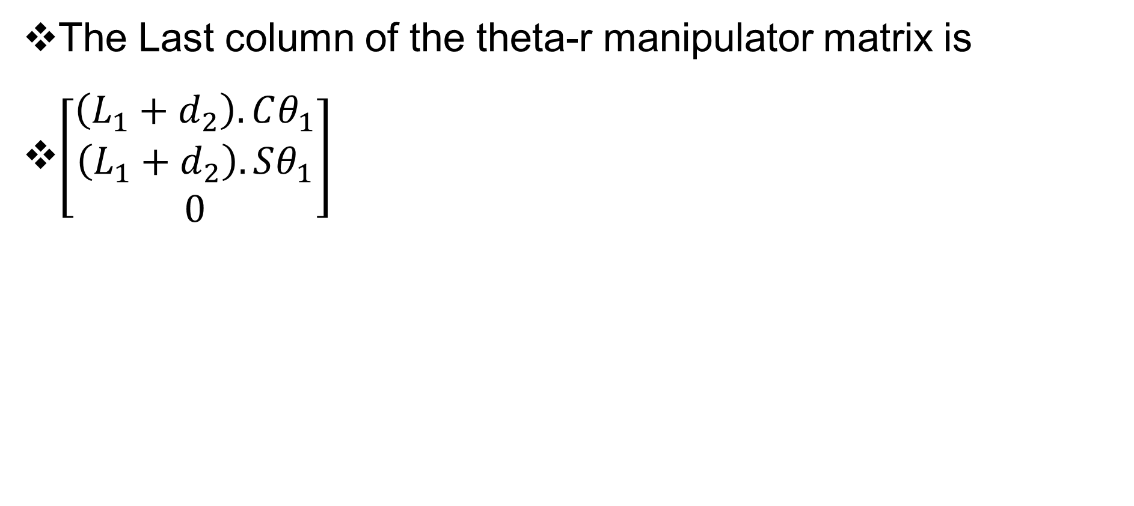
2 dof manipulator – Forward Kinematics
The Last column of the theta-r manipulator matrix is
$\left[\begin{matrix}\left(L_{1}+d_{2}\right).Cθ_{1} \\ \left(L_{1}+d_{2}\right).Sθ_{1} \\ 0\end{matrix}\right]$

Slide 25
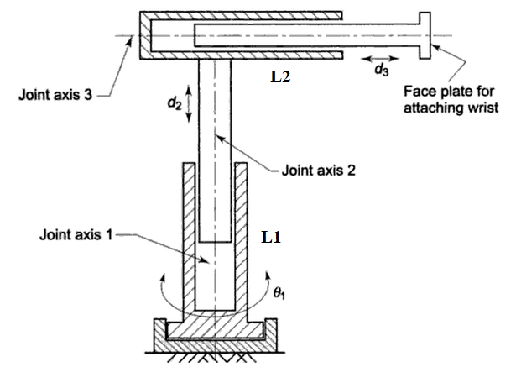
Cylindrical arm – Forward Kinematics

Slide 26
THANK YOU
The presenter is grateful to the authors of the following text books.
Industrial Robotics - Mikell P. Groover
Industrial Robotics Computer Interfacing and Control – Wesley E. Snyder
Fundamentals of Robotics – Robert Schilling

